Slide 1
Work

Slide 2

In this Smart Lesson you will learn to:
Define the term mechanical work.
Solve problems involving work done by a force.

Slide 3

Work is a very important idea in physics.
We can think about work in terms of energy and forces.
It might be a bit confusing to deal with work as an idea from physics when you're used to work meaning a job or doing your homework. In physics, work isn't about how difficult something is - physicists were just being silly when they named this concept!

Slide 4
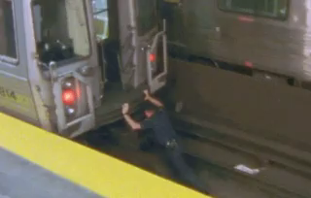
Work is the amount of energy that is transferred to an object when a force causes it to move.
If the object does not move, then no work has been done on it!
Similarly, if there is no force being applied to the object, there is no work being done on it, even if the object continues moving.

Slide 5

Let's say that you push against a wall.
No matter how hard you push, you cannot move the wall.
Even though you are applying a force to the wall and getting very tired, you are not doing work!
Work is only done when the force causes the object to move.

Slide 6
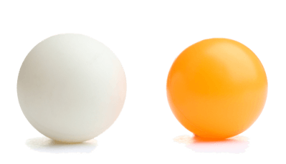
Next, you gently touch a ping pong ball and cause it to roll away from you.
Even though this didn't take much effort, you still did work!
This is because you applied a force to the ping pong ball that caused it to move.

Slide 7
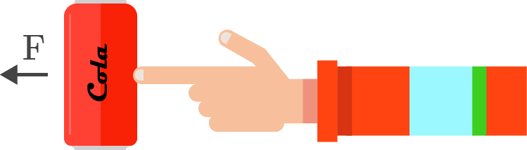
Mechanical work is defined as the transfer of energy to or from an object by the action of a force over a distance.

Slide 8

The unit for work is the joule (J).
We use joules as a unit for work because work is the amount of energy that is transferred to an object, and energy is measured in joules.
As work is the product of force and distance, the units are also newton metres (Nm).
1 J=1 Nm

Slide 9
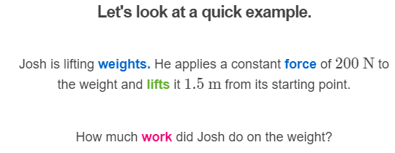
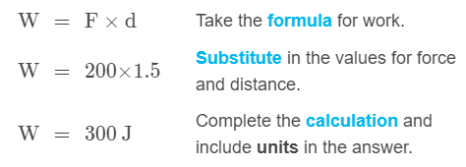

Slide 10
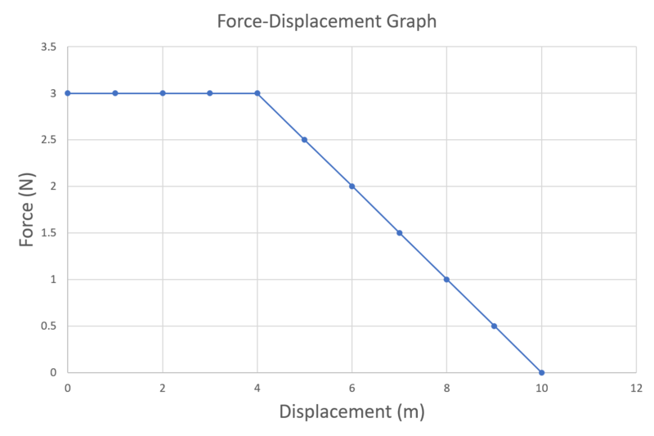
Another way to calculate work is to look at a force-displacement graph.
When the force applied is plotted against displacement, the area under the graph is equal to the work done.
For example, look at the graph below. What is the work done?

Slide 11
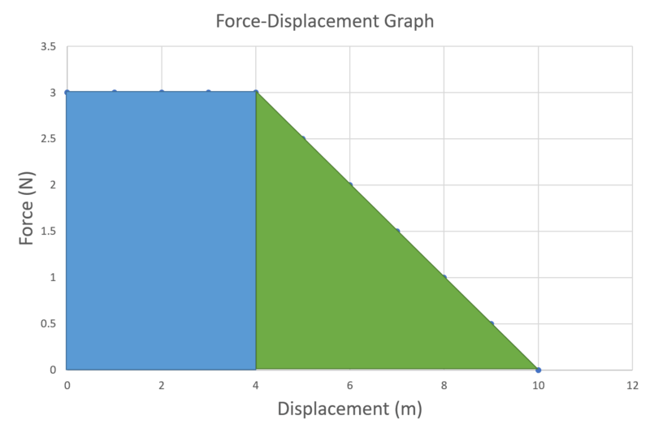
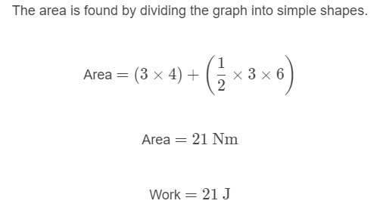
To calculate the work, find the area under the graph.

Slide 12
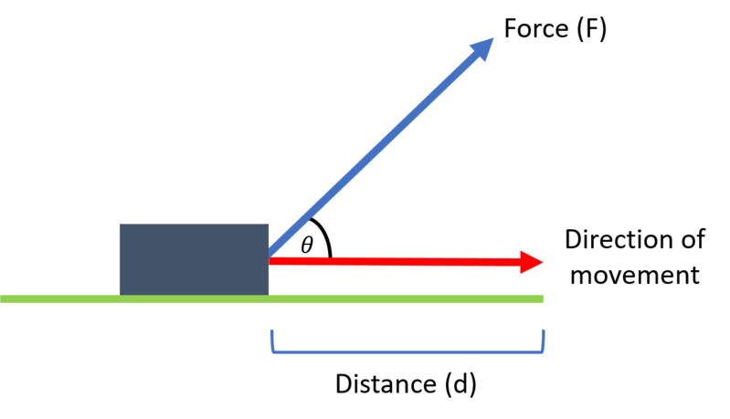
Extension: Forces on an angle
Sometimes forces are applied on an angle. When this occurs we only look at the component of force that is parallel to the direction the object moves in. This means that a force acting perpendicular to the direction of motion does no work on the object.
When a force is applied in the same direction as the motion we use the formula:
W=Fd
When a force is applied on an angle we use the formula:
W=Fdcosθ

Slide 13
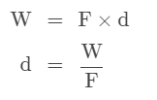
We may also want to find the distance that an object travels while a force is applied to it.
We do this by rearranging the work formula.
To make distance the subject of the formula, we divide both sides of the formula by force.
To use this formula, work must be in joules (J) and force must be in newtons (N).

Slide 14
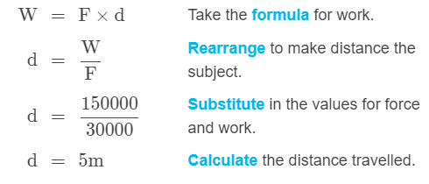
Let's look at an example of calculating distance from work and force.
A car that weighs 30000 N does 150000 J of work while it drives up the hill. How far does the car drive up the hill?

Slide 15
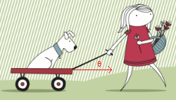
Extension: Forces on an angle
For example, what is the work done when Sarah pulls her dog along on a trolley for 10 m if she is pulling with a force of 50 N at an angle of 30∘?
W=Fdcosθ
W=50×10×cos30∘
W=430 J (2SF)

Slide 16
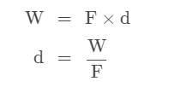
We may also want to find the distance that an object travels while a force is applied to it.
We do this by rearranging the work formula.
To make distance the subject of the formula, we divide both sides of the formula by force.
To use this formula, work must be in joules (J) and force must be in newtons (N).

Slide 17
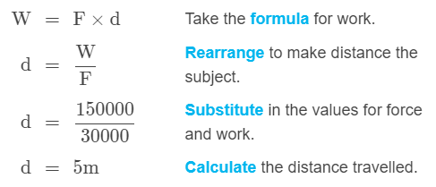
Let's look at an example of calculating distance from work and force.
A car that weighs 30000 N does 150000 J of work while it drives up the hill. How far does the car drive up the hill?

Slide 18
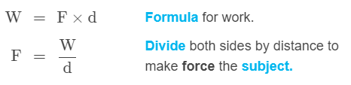
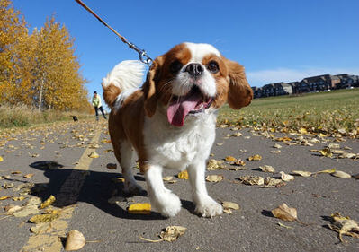
In order to find the force applied to an object, we need to rearrange the work formula.

Slide 19
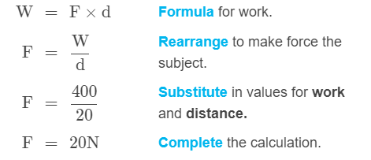
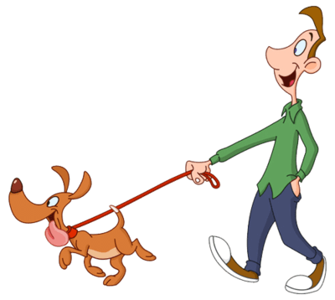
Worked example calculating force from work and distance.
A dog is pulling on its lead. It does 400 J of work and moves 20 m. How much force does the dog apply to the lead?

